Slide 1
MGM COLLEGE OF ENGINEERING AND TECHNOLOGY
LOTUS SQL
Guide:
Mrs. Deepa P L
Assistant Professor
Department of Computer Science
Presented By:
Bibin P Varghese
HKC18CS021
S7 Computer Science

Slide 2
Table of contents
Objective
Introduction
BACKGROUND –Lotus
BACKGROUND–calcite
WORKFLOW
Physical Operators
Query optimization
Evaluation
Advantages and Disadvantages
Conclusion
References

Slide 3
Objective
An engine to provide SQL support for dataset abstraction on native backend Lotus
Convenient SQL processing framework to deal with frontend jobs

Slide 4
INTRODUCTION
Rapid development of information technology has brought significant progress to human society
The amount of data that computer systems need to deal with has increased accordingly
SQL is a common choice for data analysis
To evaluate the execution efficiency of SQL queries TPC defines a benchmark TPC-H is widely used for OLAP performance evaluation.
SparkSQL is designed for processing structured data on Spark.

Slide 5
Introdution (Cont….)
Garbage collection and data serialization, are attributable to JVMs
Lotus is a high performance data-parallel computing engine built with c++
High performance because of bare-metal runtime environment
Compact storage strategy,Coarse-grained function call,Memory efficient design
Uses template usage and automatic type deduction
Challenges :Semantic gap exists between lotus and SQL and Massive development efforts

Slide 6
BACKGROUND -Lotus
Single machine data parallel computing engine
Low-overhead storage module & Highly efficient compute modue
Storage module is designed to have low overhead ,combination of buffer caches and compact object models
Compute model is C++ dataset programming model
Provides the abstraction of compact collections and efficient operation implementations
Logically an array of records segmented into multiple partitions

Slide 7
BACKGROUND–Lotus (Cont….)
Abstraction is quite similar to spark’s RDD for distributed allocation
Lazy evaluation strategy and supports fault tolerance
Intermediate result datasets can be cached explicitly
Employs compact object storage
Reduce serialization and deserialization overhead
Supports primary data types
For string dataset, data are organized into two compact buffers
Provide a compute engine for LotusSQL

Slide 8
BACKGROUND–calcite
Open-source software framework
Provides query processing , optimization and query language support
Perceives developers of specialized systems encounter related problems such as query optimization or the need to support query language
Minimize the engineering effort
Unifying and pluggable framework

Slide 9
BACKGROUND–calcite (Cont….)
Logical operators is the primary form of operation and it includes filter , project and join
Physical operator assigns an implementation method
Operators compose the relational algebra expression tree, which is the representation of an execution plan
Execution plan consisting mainly of physical operators called physical plan
Cost-based dynamic programming search to find the best execution plan
Employs as a frontend to produce a physical execution plan.

Slide 10
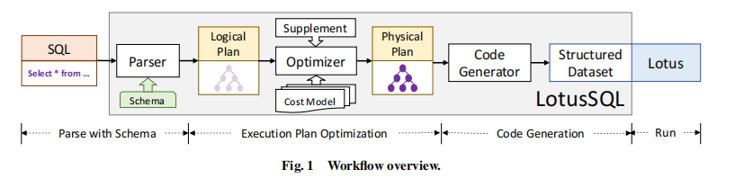
WORKFLOW

Slide 11
PHYSICAL OPERATORS
PHYSICAL OPERATORS-OPERATION FUSION
Technique to dataset operation implementation
Proposed in the main memory database field
Operation can be fused together to maximize data and code locality
Leaves tuples in registers and makes the execution cheap

Slide 12
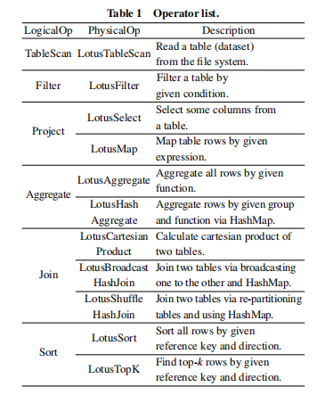
Implementation and cost model

Slide 13
Implementation and cost model
Cost model evaluates cost of the implementation
Generally the cost can be calculated in several aspects , such as CPU usage , memory access and I/O bytes.

Slide 14
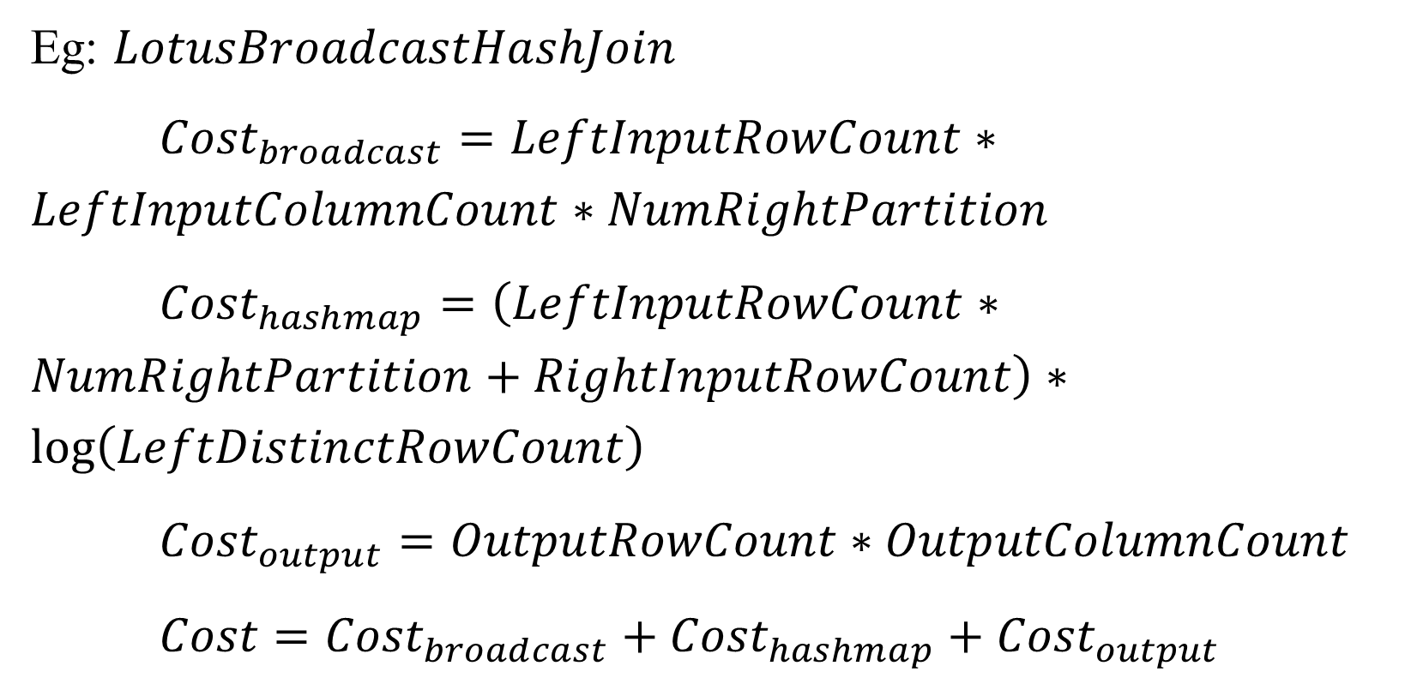
Implementation and cost model
Eg: $LotusBroadcastHashJoin$
${Cost}_{broadcast}=LeftInputRowCount∗LeftInputColumnCount∗NumRightPartition$
${Cost}_{hashmap}=\left(LeftInputRowCount∗NumRightPartition+RightInputRowCount\right)∗\log\left(LeftDistinctRowCount\right)$
${Cost}_{output}=OutputRowCount∗OutputColumnCount$
$Cost={Cost}_{broadcast}+{Cost}_{hashmap}+{Cost}_{output}$

Slide 15
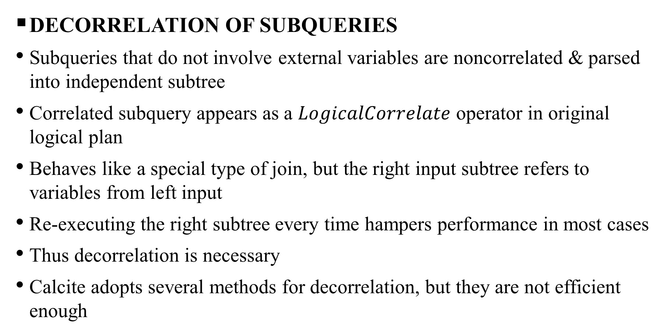
Query optimization
DECORRELATION OF SUBQUERIES
Subqueries that do not involve external variables are noncorrelated & parsed into independent subtree
Correlated subquery appears as a $LogicalCorrelate$ operator in original logical plan
Behaves like a special type of join, but the right input subtree refers to variables from left input
Re-executing the right subtree every time hampers performance in most cases
Thus decorrelation is necessary
Calcite adopts several methods for decorrelation, but they are not efficient enough

Slide 16
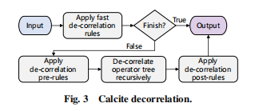
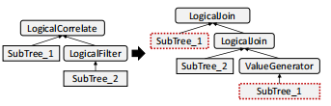
DECORRELATION OF SUBQUERIES (CONT..)
Fig.1 Calcite decorrelation
Fig.2 Decorrelation Example

Slide 17
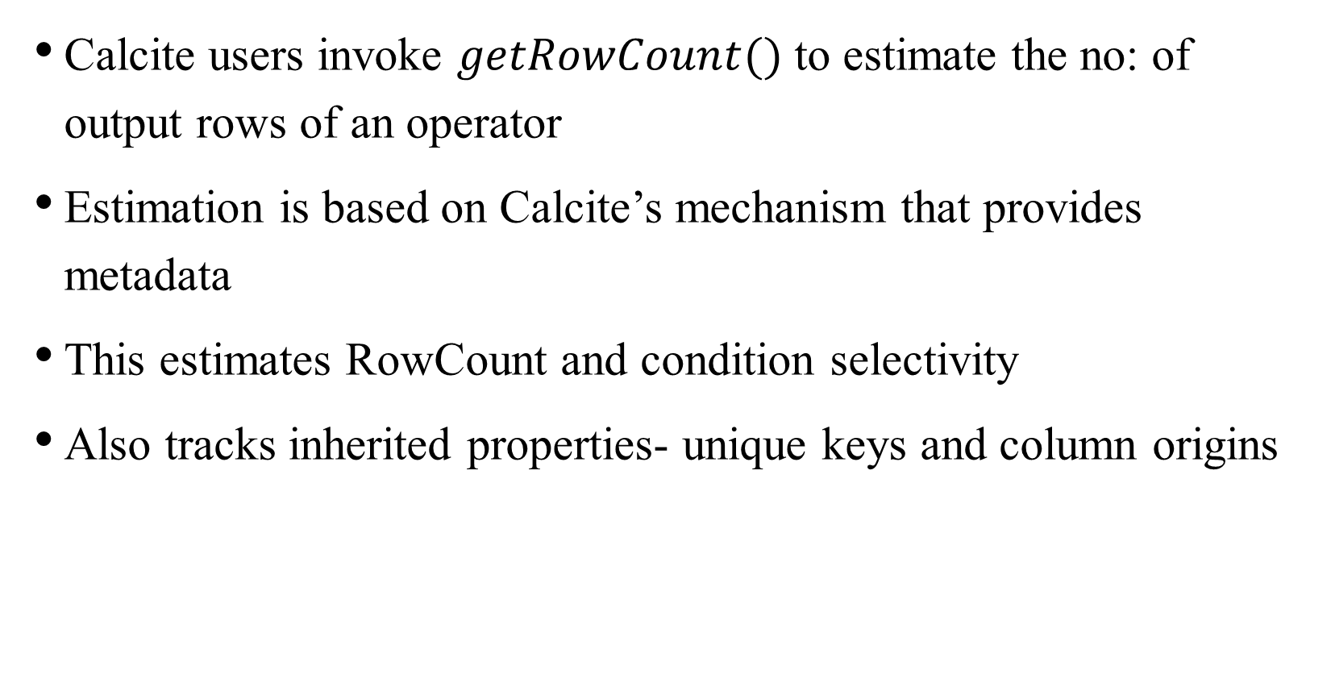
Rowcount estimation
Calcite users invoke $getRowCount()$ to estimate the no: of output rows of an operator
Estimation is based on Calcite’s mechanism that provides metadata
This estimates RowCount and condition selectivity
Also tracks inherited properties- unique keys and column origins

Slide 18
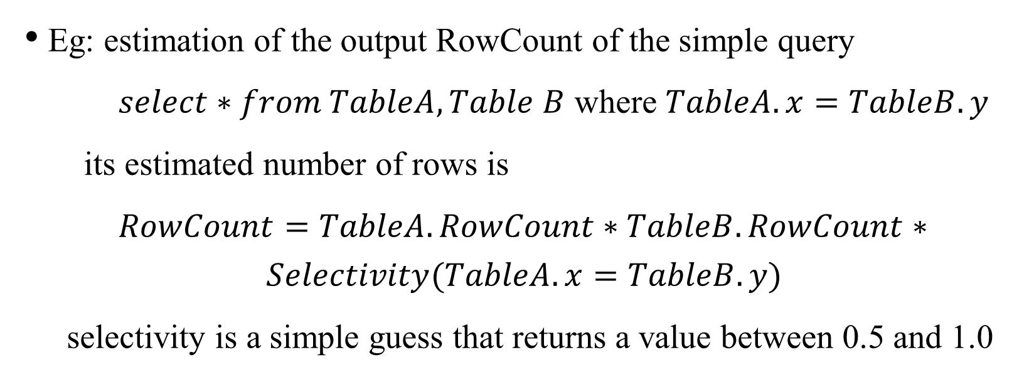
Rowcount estimation
Eg: estimation of the output RowCount of the simple query
$select∗from TableA,Table B$ where $TableA.x=TableB.y$
its estimated number of rows is
$RowCount=TableA.RowCount∗TableB.RowCount∗$
$$Selectivity(TableA.x=TableB.y)$$
selectivity is a simple guess that returns a value between 0.5 and 1.0

Slide 19
EVALUATION
Workloads and environment
Query translation analysis
Computing time
Memory usage

Slide 20
ADVAntages
Big data processing system
Takes less memory
DISADVANTAGES
Complex
Long queries

Slide 21
conclusion
Lotus is a big data processing system developed with native programming language
To boost lotus we present LotusSQL
Uses Calcite to compile and optimize queries with the guidance of a physical cost model
Dependencies are resolved as a whole and compressed during C++ compilation time
With all the about strategies, LotusSQL outperforms SparkSQL in TPC-H queries by more than twice on average

Slide 22
References
[1] Apache Hadoop, Apache hadoop, http://hadoop.apache.org, 2021.
[2] J. Ekanayake, H. Li, B. J. Zhang, T. Gunarathne, S. H. Bae, J. Qiu, and G. Fox, Twister: A runtime for
iterative mapreduce, in Proc. 19th ACM Int. Symp. on High Performance Distributed Computing,
Chicago, IL, USA,2010, pp. 810–818.
[3] Y. Y. Bu, B. Howe, M. Balazinska, and M. D. Ernst, HaLoop: Effificient iterative data processing on large clusters, Proc. VLDB Endowm., vol. 3, nos. 1&2, pp. 285–296, 2010.
[4] G. M. Essertel, R. Y. Tahboub, J. M. Decker, K. J. Brown, K. Olukotun, and T. Rompf, Flare: Optimizing apache spark with native compilation for scale-up architectures and medium-size data, in Proc. of the 13th USENIX Conf. on Operating Systems Design and Implementation, Berkeley, CA, USA, 2018, pp. 799–815.
[5] R. S. Xin, J. Rosen, M. Zaharia, M. J. Franklin, S. Shenker, and I. Stoica, Shark: SQL and rich analytics at scale, in Proc. 2013 ACM SIGMOD Int. Conf. on Management of Data, New York, NY, USA, 2013, pp. 13–24

Slide 23
Thank you

